Slide 1
Architectural Risk
How to Find, Model & Manage Risk in Large, Technical Programs

Slide 2
Fitzgerald’s First Law of Program Management
“There are two states to any large project: Too early to tell and too late to stop.”
Ernest Fitzgerald.
Former Engineer and Manager, USAF

Slide 3

Defining Business Risk

Slide 5
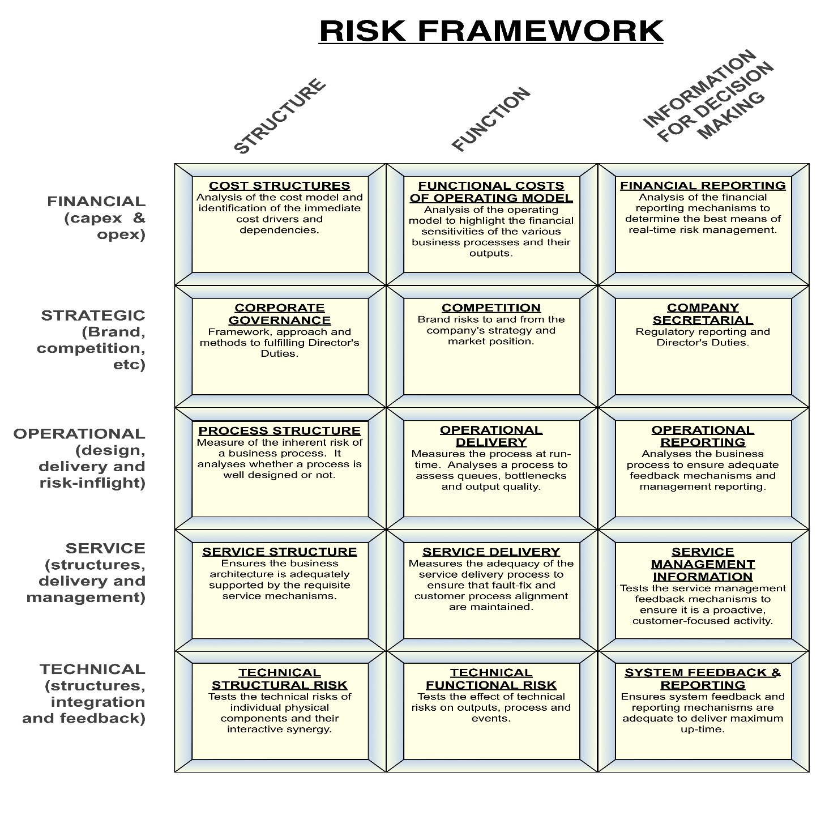

Slide 6

Viability

Slide 7
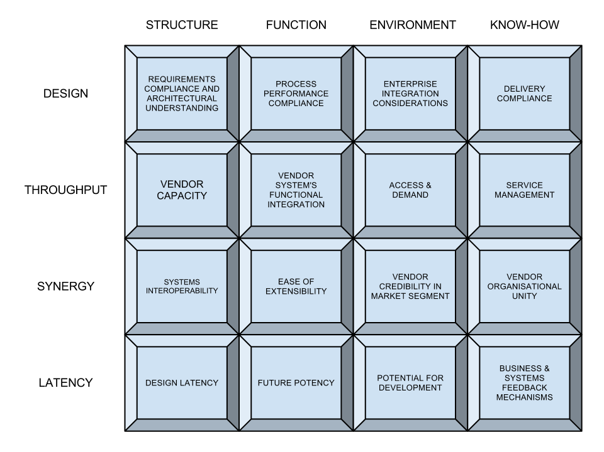
Viability Matrix

Slide 8
Hanlon’s Razor
“Never attribute to (conspiracy) that which is (best) explained by stupidity.”
Robert J Hanlon (poss).

Slide 9
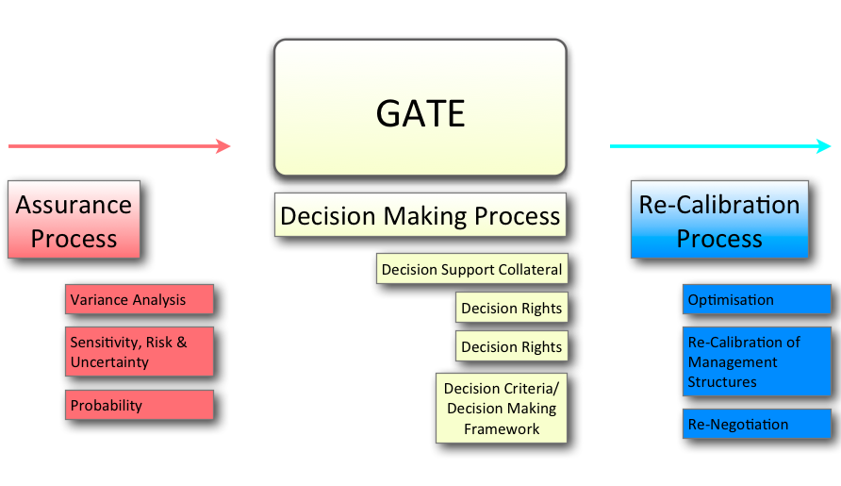
Engineering Systems v Systems Engineering

Slide 10
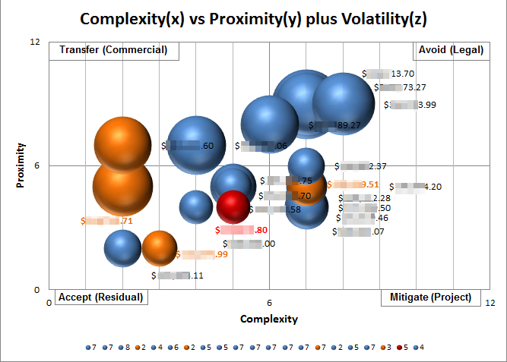

Slide 11
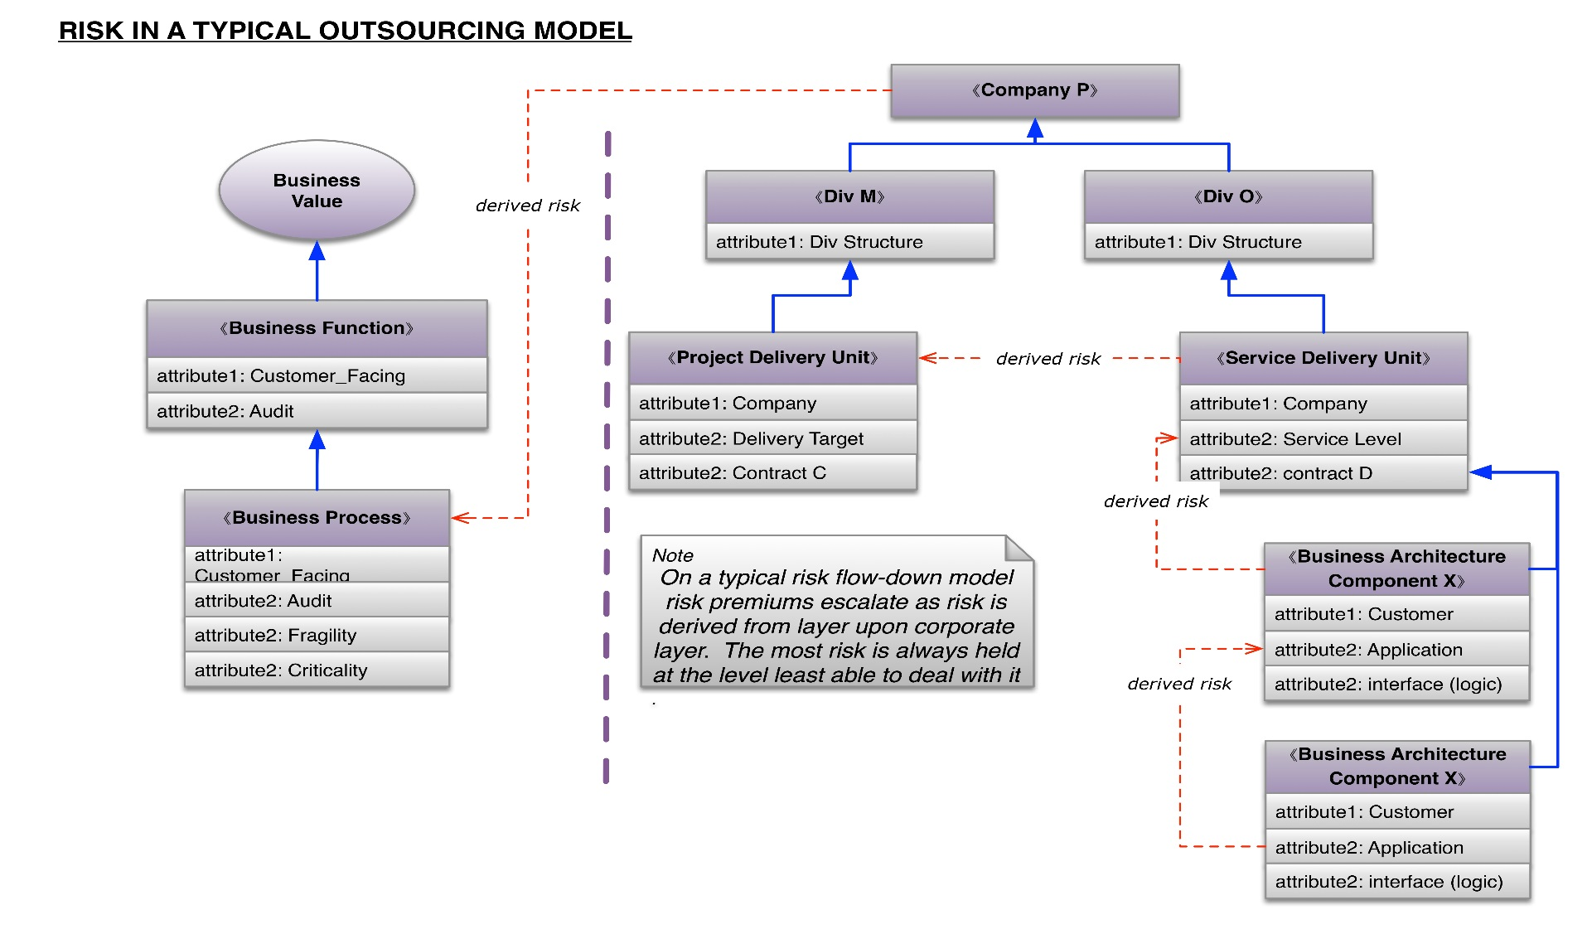
Technical Risk

Slide 13
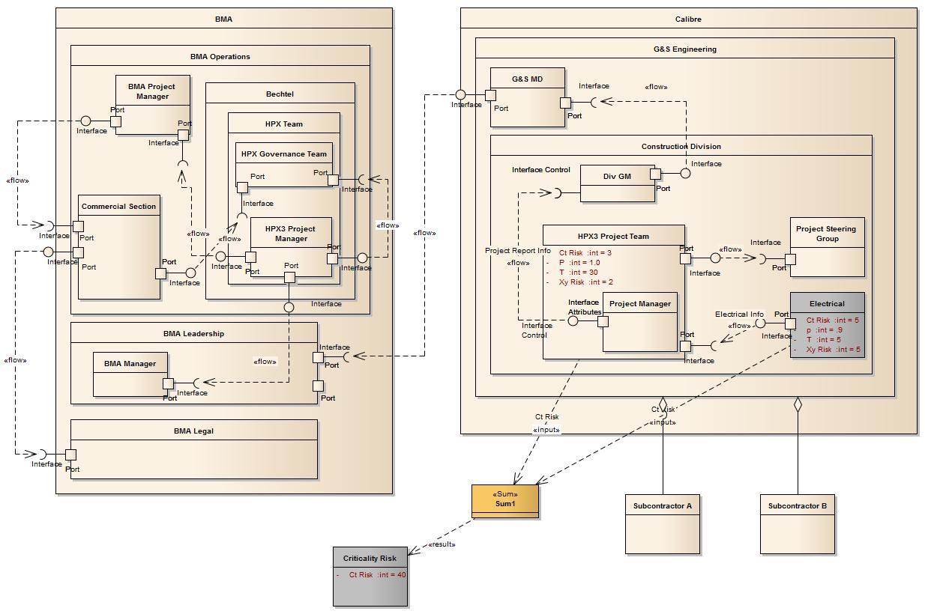
Business Risk

Slide 14
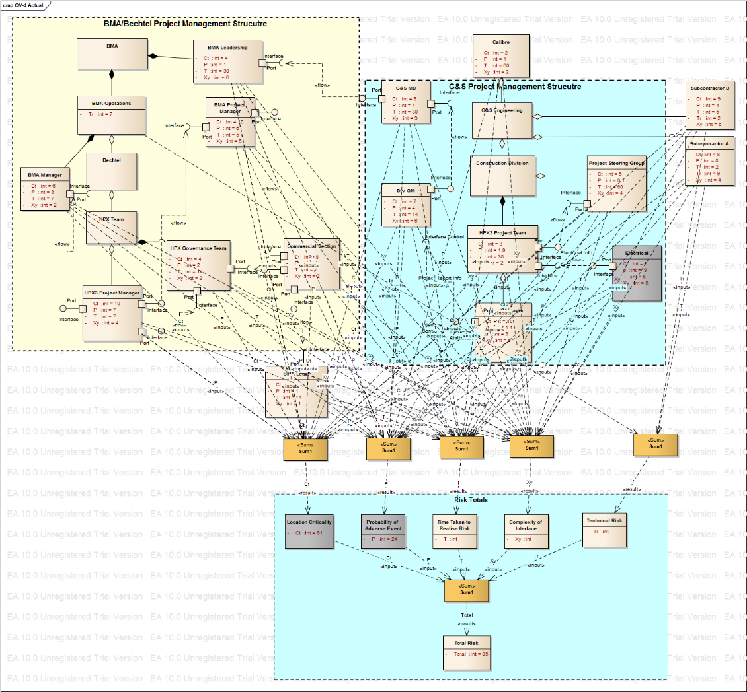

Slide 15
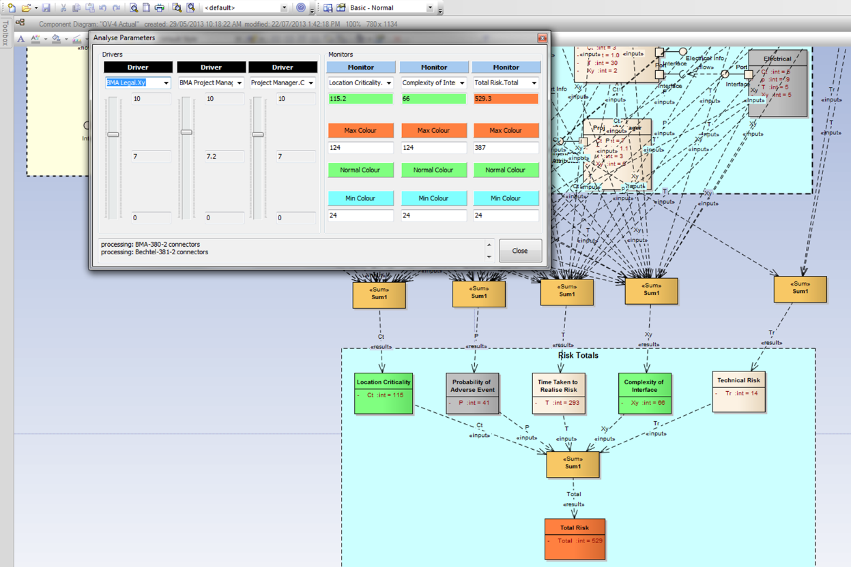

Slide 16
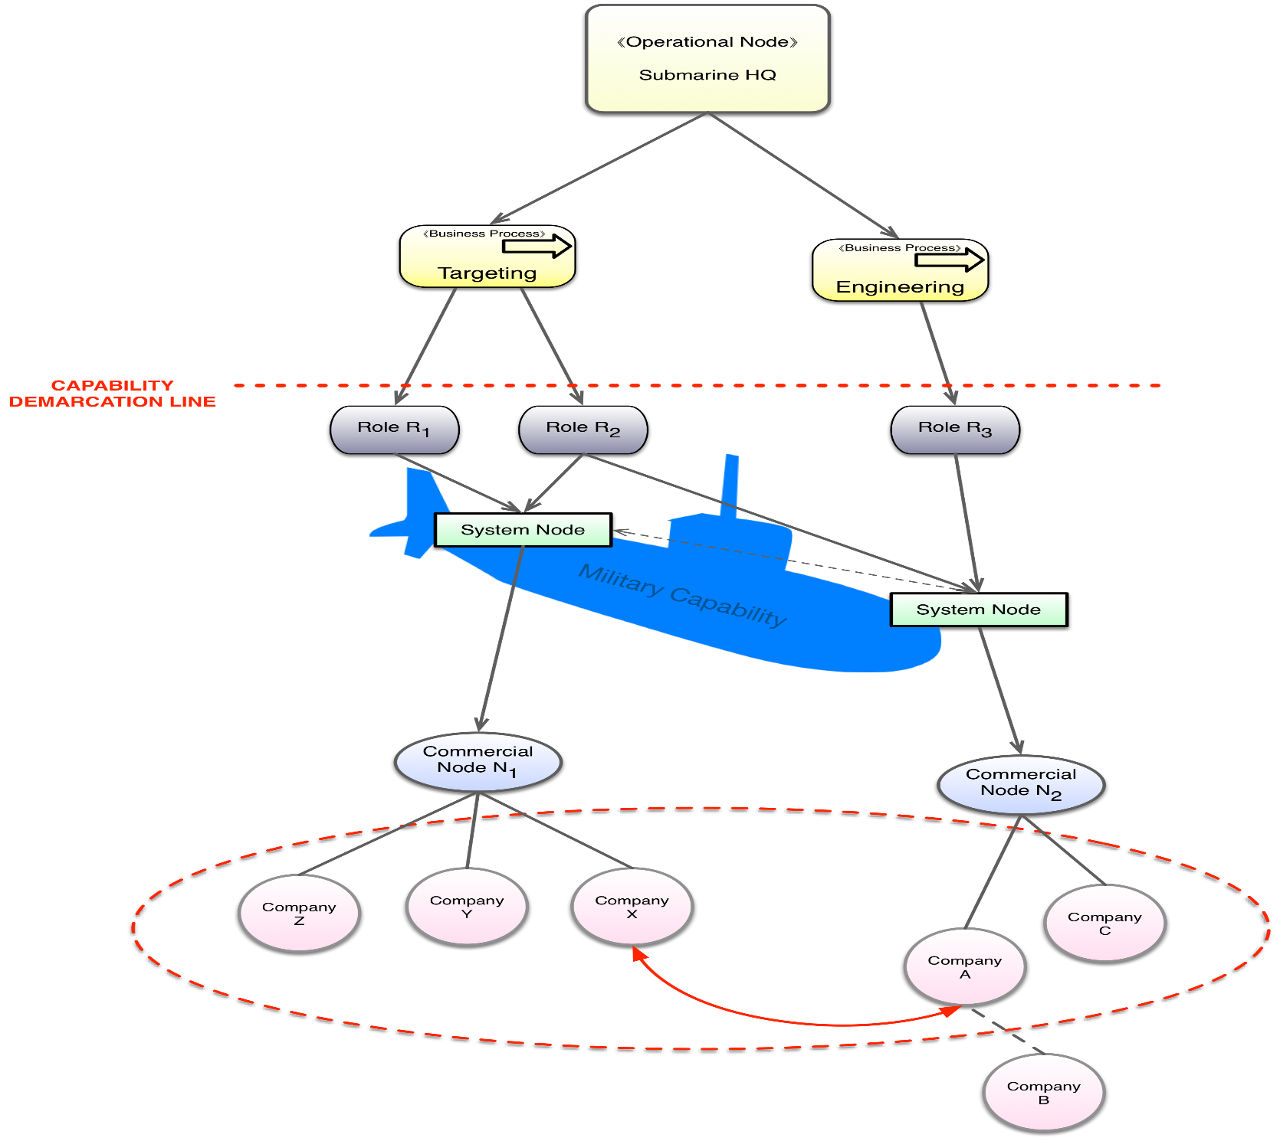
Contracting For Capability

